Slide 1


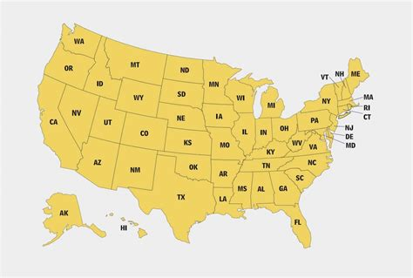

Impact of Vaccination on Covid-mortality Rate in the United States
Bhavya Sharma
Department of Geography, University of Nebraska Kearney
[Faculty Advisor: Dr. Vijendra Boken]
Introduction
Methods
Conclusion
Covid-19 is a pandemic which began in the year 2020. Many jobs, lives, and livelihoods have been lost due to this virus, but in 2021, vaccines were finally made available. These vaccines are said to “reduce the risk of severe illness from covid,” and “help develop immunity to the virus which causes covid((Understanding How COVID-19 Vaccines Work)).” Yet there has been a lot of speculation as to weather the vaccines are truly effective or not. This is what I have researched and presented in this poster.
I collected data csv’s about state populations per year and collected csv’s about state vaccinations, cases, and deaths, which were given daily. I then compiled the csv’s into one excel file and separated each data csv by spreadsheets. I then summed up the datasets to show the cumulative number of cases/vaccinations/deaths per year and sorted the data by highest number of cases/ vaccinations/deaths to lowest. After that I did an analysis of the states with the highest mortality rate and the states with highest vaccinations and lowest mortality rate. I also determined the correlation coefficient between number of vaccinations v/s mortality rate and number of vaccinations v/s covid cases.
Vaccinations play a pivotal role in curbing covid-19 cases/ deaths, and should be promoted as much as possible
.
Study area
Figure2.
Results and Discussion
References
The study included all the united states, and studied the number of vaccinations, total positive cases, and total vaccinations.
Vaccinations started getting widely distributed
across the united states in 2021, which were supposed to help curb covid cases and reduce
deaths. New York was one of the top 3 states with most deaths in 2020, but after vaccinations started, deaths went down considerably. Vermont was the topmost vaccinated state in 2021 as well as the state with the lowest mortality rate, which proves that vaccinations have a considerable impact on covid-19 cases/deaths. On November 19, 2020, The real deal reported “The city’s public school system will shut down as of Thursday after virus cases hit 3 percent over a seven-day average, according to Mayor Bill de Blasio.”, but the cases dropped considerably after vaccinations started becoming distributed across the states. Some Statistics about covid:
2020-0.11% of USA died due to covid
2020-6.06 USA population tested positive for covid
2021- 0.14% mortality rate nation wise
2021- 10.3% positive nation wise
Covid-19 vaccinations in the U.S: https://ourworldindata.org/us-states-vaccinations
Covid-19 cases and deaths per state and county: https://usafacts.org/visualizations/coronavirus-covid-19-spread-map/
Vaccinations per state: https://usafacts.org/visualizations/covid-vaccine-tracker-states/
State-Wise population 2020: https://state.1keydata.com/state-population.php
State-Wise population 2021: https:// /states
Staff, TRD. “New York Braces for Another Lockdown as Covid Cases Surge.” The Real Deal New York, 19 Nov. 2020, https://therealdeal.com/2020/11/19/real-estate-braces-for-new-restrictions-as-virus-cases-surge/.
“Understanding How COVID-19 Vaccines Work.” Centers for Disease Control and Prevention, 24 Feb. 2022, www.cdc.gov/coronavirus/2019-ncov/vaccines/different-vaccines/how-they-work.html.
Figure1.
Figure 4
Data used
Figure 3
Data included Covid-19 cases, deaths and vaccinations from usafacts.org, and the population census of 2020 was taken from state.1keydata.com while the data for 2021 population census was taken from worldpopulationreview.com.

